Slide 1
Introduction to Git and version control for managing code.

Slide 2
Version control is a system that tracks changes to files over time so that you can: 1.An older version is a previous state of your project — exactly how your files looked at a certain point in time. This happens every time you make a commit. Git takes a snapshot of all your files at that moment and saves it as a version. Imagine you're writing a document. Every time you save it with a new filename: version1.docx – the first draft version2.docx – after you fixed some typos version3.docx – after adding new content Each of these is an older version compared to the next one. Git does this automatically — you don’t need to rename anything Example in Git: You’re making a website: First commit:
Files: index.html, style.css
Message: "Initial layout" Second commit: You added a new section to the homepage
Message: "Add About Us section"
Third commit:
You changed colors in CSS
Message: "Update color scheme" Each commit is a version. If you realize the new color scheme is bad, you can go back to version 2 the one with the old colors.
Introduction to Version Control :

Slide 3
Git is a version control system that helps you track changes in your files, collaborate with others, and manage project history. 1.Tracks every change you make to your project 2.Lets you go back to previous versions 3.Lets multiple people work on the same project at the same time 4.Helps you merge changes together 5.Stores your project locally, and can also sync it online (e.g., with GitHub)
What is Git?

Slide 4


Git keeps all these versions safely stored inside the hidden .git folder in your project. You can: View them with git log Switch between them Compare them Restore any version 2.Work with others on the same project without overwriting each other’s work Work on different parts of a project independently Combine work later without confusion Example: You and your friend are building a website: You are working on the homepage. Your friend is working on the contact form 1.Each of you creates your own branch: 2.You both work separately and commit your changes. 3.Later, you merge both branches into the main project 3.See who made changes, what they changed, and when

Slide 5
Track Changes : You’re building a website. You change the color scheme, but then realize it looks bad. With Git, you can go back to the version where the color scheme was perfect. Work with Others : One of you works on the homepage, the other works on the contact form. When you're done, Git helps you combine the work without conflicts. Experiment without Risk : You want to try adding a new feature (like a "login" page), but you’re not sure it will work. So, you create a new branch, try it out, and if it’s good, you merge it into your main project. Backup Your Work : You make a lot of changes to your project. Git allows you to push (upload) those changes to GitHub, and if your computer crashes, you can recover your project.
Why Use Git?

Slide 6
Repository (Repo) : A repository is like a folder for your project. It contains all your project files and the history of changes made to them Local Repository: The one on your own computer. Remote Repository: A copy of your repo stored online (like on GitHub). Example: You have a folder called my-website/ on your computer, which is your local repository. You can upload it to GitHub, where it becomes your remote repository. Commit : A commit is like a snapshot of your project at a certain point in time.
It records the changes you made.
Each commit has a message explaining what was changed.
Example: After finishing the homepage design, you commit your changes with a message like "Homepage layout complete." Branch : A branch is like a separate path or version of your project where you can work on new features or fix things without affecting the main project. Merge : Merging is when you combine changes from one branch into another. For example, you can merge a feature branch into the main branch. Push : Pushing is uploading your changes from your local repository to a remote repository (like GitHub).After adding a new feature, you push your changes to GitHub so that your team can access them. Pull : Pulling is downloading the latest changes from a remote repository to your local repository. Your team made updates to the project on GitHub. Before you start working, you pull the latest changes to get the most recent version of the project. Pull Request (PR) : A Pull Request is when you ask to merge your changes into someone else's project or main branch. Others can review your changes before they are merged. It's a great way to collaborate with others and get feedback.
Key Git Terminology

Slide 7
Checkout : Checkout lets you switch between branches Example: You’re working on the feature-login branch, and you want to switch to the main branch to check something. You would use git checkout main. Staging : Staged files are files that are ready to be committed to the repository you are working on .When you first add files to an empty repository , they are all untracked . To get git to track them, you need to stage them, or add them to the staging environment. Git help : If you are having trouble remembering commands, you can use git help.

Slide 8
GitHub is a web-based platform used by developers to: Store code Track changes using Git Collaborate with others Publish projects online GitHub lives on the internet — that means you can: Access your code from anywhere Back up your work Share it with others easily Real-World Example
Let’s say you're building a personal website:
You start with files on your laptop.
You use Git to track changes as you build (git commit).
You create a GitHub repo and push your code there.
A friend finds a typo and fixes it, then sends you a pull request.
You accept the pull request — your site is now better, and the work is all tracked.
What is GitHub?

Slide 9
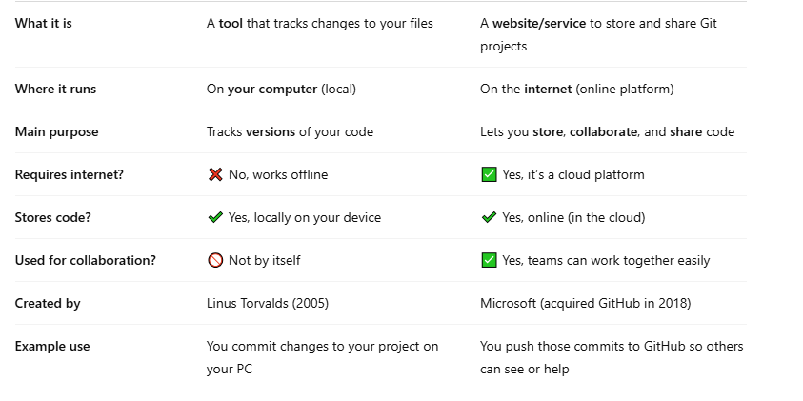
Difference Between Git and GitHub

Slide 10




1. git init : Use: To start a new Git repository in your project folder. What it does: Tells Git to start tracking changes in this folder. 2.git commit -m "message" : Use: To save your staged changes with a message describing what you did. What it does: Creates a snapshot in your Git history. 3.git push : Use: To upload your local commits to a remote repository (like GitHub). What it does: Shares your work with others. 4.git pull : Use: To download and merge the latest changes from the remote repository. What it does: Keeps your local copy up to date.
Basic Git Commands

Slide 11



5.git branch and git branch <name> : Shows your branches or creates a new one. Branches let you work on new features or ideas without affecting the main code. 6.git log : Shows a list of all commits you've made. You’ll see: Who made them When they were made Commit messages 7.git rm <file> : Deletes a file and tells Git to stop tracking it.

Slide 12




8.git merge <branch> : Combines another branch into your current branch. 9.git status : Shows the current state of your project. Which files were changed Which files are ready to be committed Which files Git is not tracking yet 10.git add <filename> : Prepares changes to be committed — it stages them.
This command stages changes in your files — meaning, it prepares them to be saved (committed) in Git. Git doesn’t automatically save everything you do. You choose which files/changes you want to include in the next snapshot (commit). This is done using git add. 11.git checkout <branch-name> : This command switches you to a different branch in your Git project.

Slide 13
Benefits of Git (the tool on your computer) : 1.Version History 2.Safe Experimentation 3.Control & Clarity 4.No Accidental Overwrites Benefits of GitHub : 1.Cloud Backup 2.Team Collaboration 3.Pull Requests & Code Reviews 4.Transparency
Benefits of Git & GitHub

Slide 14
Thank you

